Slide 1
Exit presentation
“For every dark night there is a brighter day” –Tupac
By Christopher E. Misaalefua
Notes:
Say full name

Slide 2
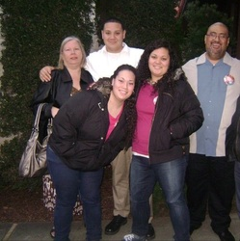
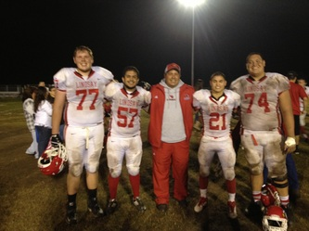
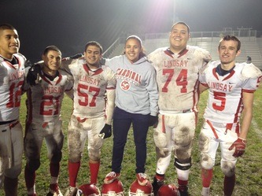
About me
Born in Visalia
Lived in Lindsay all my life
Youngest of 4
Hobbies
  Family oriented, Working out, Hanging out with friends
Clubs/Activities
  Avid, Football Basketball, Block L

Slide 3


Preview
Senior writing and journals
My most memorable moment
Job shadow
Visual representation
After high school

Slide 4


Senior Writing & Journals
Autobiographical narrative
  Why I chose this topic?
  How does this topic relate to my future
Learned many great things from many great people
Time management
Priorities
Who I am
Memories of high school
Struggles

Slide 5
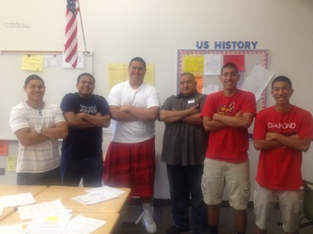
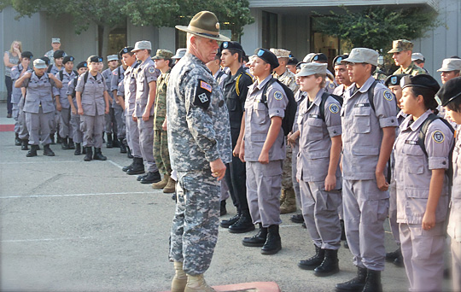
Job shadow
Michael Barrera
Works at La Sierra Middle School
One day I want help children
  A lot of great advice about kids
  Had a great time with the kids

Slide 6
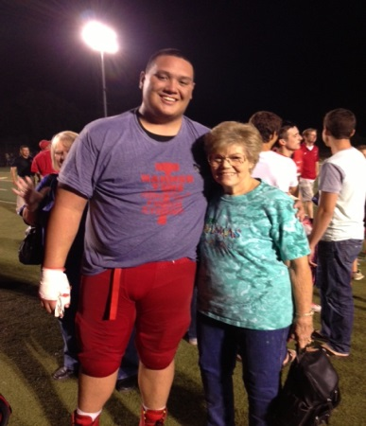
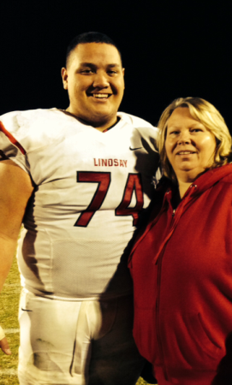
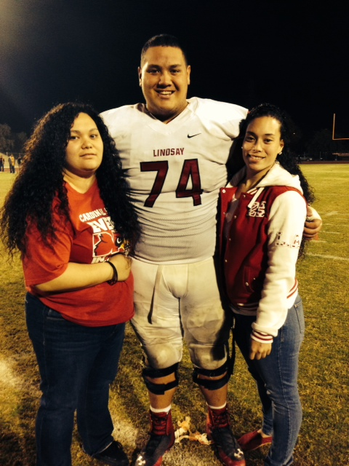
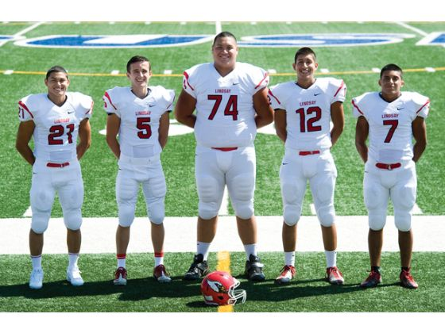
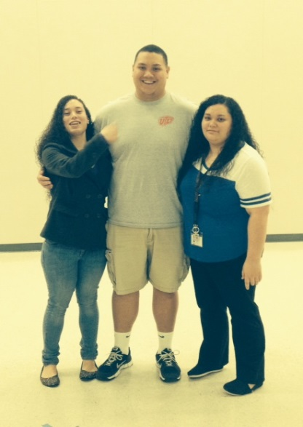
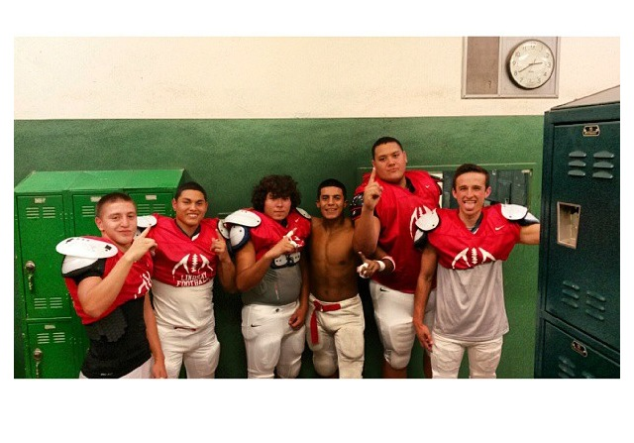
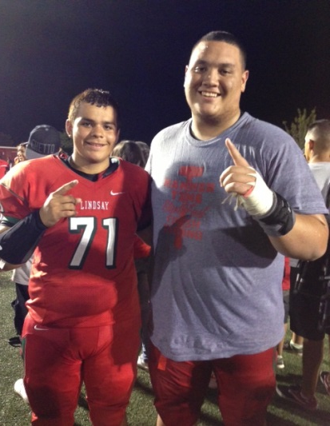
Visual representation

Slide 7



MOST MEMORIABLE MOMENT
  Signing day
  Dream come true
  More than one reason
  Changing the opinion of Lindsay

Slide 8



After high school
I will be attending the University of El Paso
I plan to major in pre-law
I wish to carry out football as long as I can
Dream Big!

Slide 9
“You got a dream... You have to protect it. People can't do something themselves, so they want to tell you, you can't do it. If you want something, go get it. Period.” – Will Smith
Thank You!
Questions?

